Slide 1
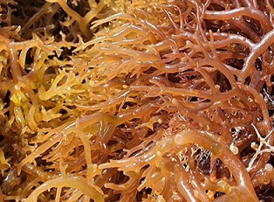
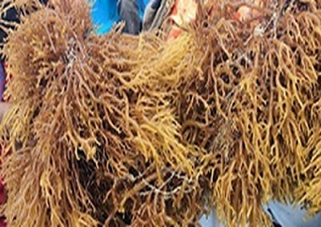
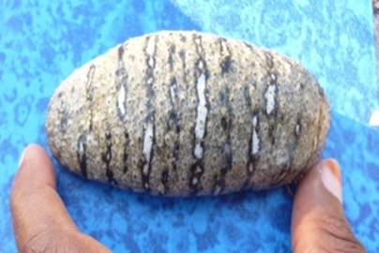
Case study : socio-economic challenges of marine resources
Flower E. Msuya, fmsuya1@gmail.com
Zanzibar Seaweed Cluster Initiative, Chamazi, Dar es Salaam
©F.E. Msuya
©F.E. Msuya

Slide 2
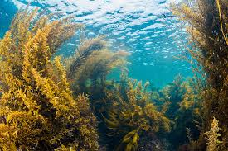
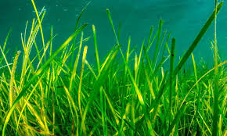
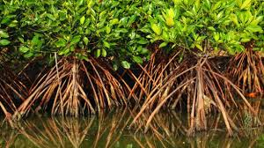
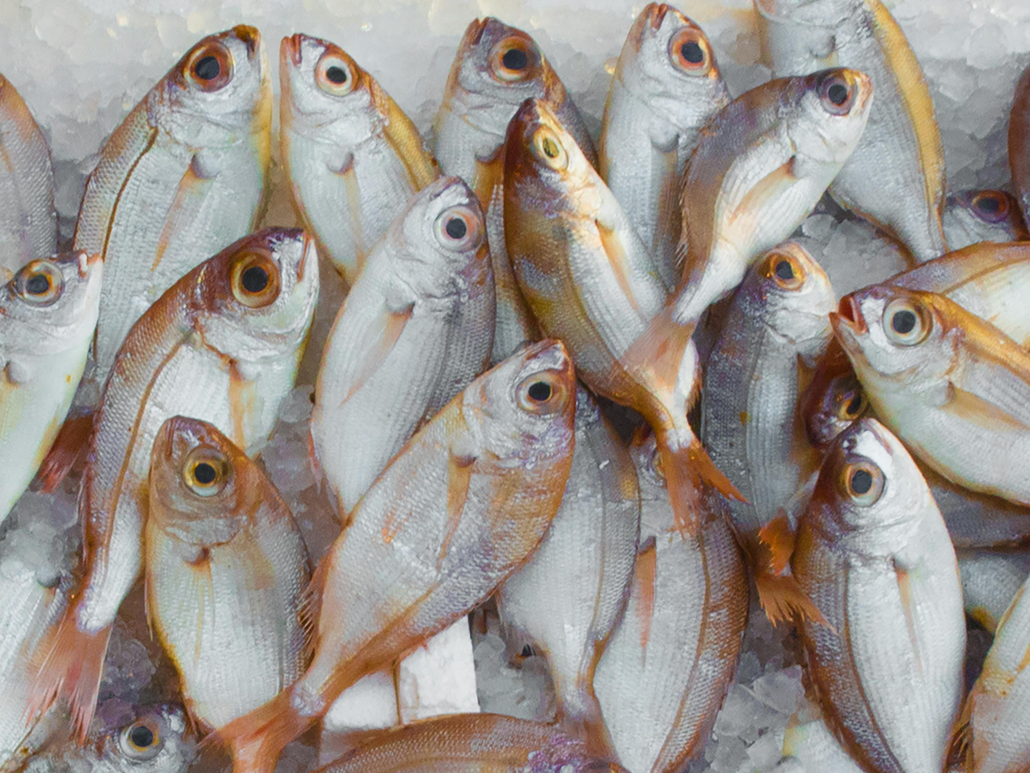
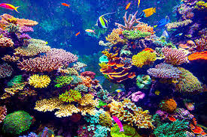
Introduction
Marine Resources include:
Seaweed/algae beds
Seagrass beds
Mangroves
Corals
Fish etc.

Slide 3
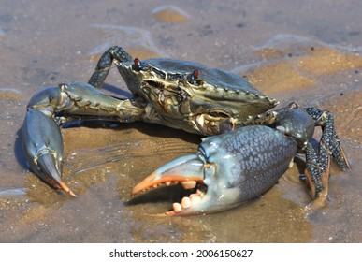
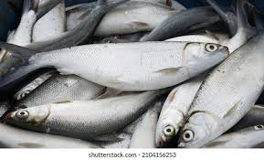
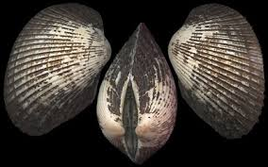
Aquaculture Marine Resources
Aquaculture for communities’ livelihood development:
Seaweed farming and value addition
Finfish
Shellfish
Crabs-mud crabs
Sea cucumbers

Slide 4
Marine Resources focused in this presentation
Aquaculture-mainly Seaweed farming and value addition

Slide 5
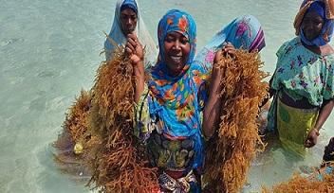
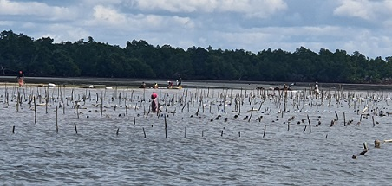
Seaweed cultivation in Tanzania
Employs ~30,000 farmers
>80% are women
Production >30,000 t (DW) annually (2024)
Proved important livelihood activity
©F.E. Msuya
©F.E. Msuya

Slide 6
The seaweed farming and export setup
France
USA
Multinational companies
Denmark
Spain
China
Chile
Local/sister companies
ZANEA
C-Weed Mwani
Ledo Biashara
ZASCOL
ZanQUE
Zanzibar Shell
Sell in villages
INOVO Co. Ltd
Hill Seaweed
Farmers

Slide 7
Red seaweed cultivation
Spinosum, US$ 0.25/kg
Cottonii, US$ 0.5$/kg

Slide 8
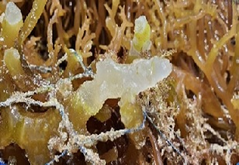
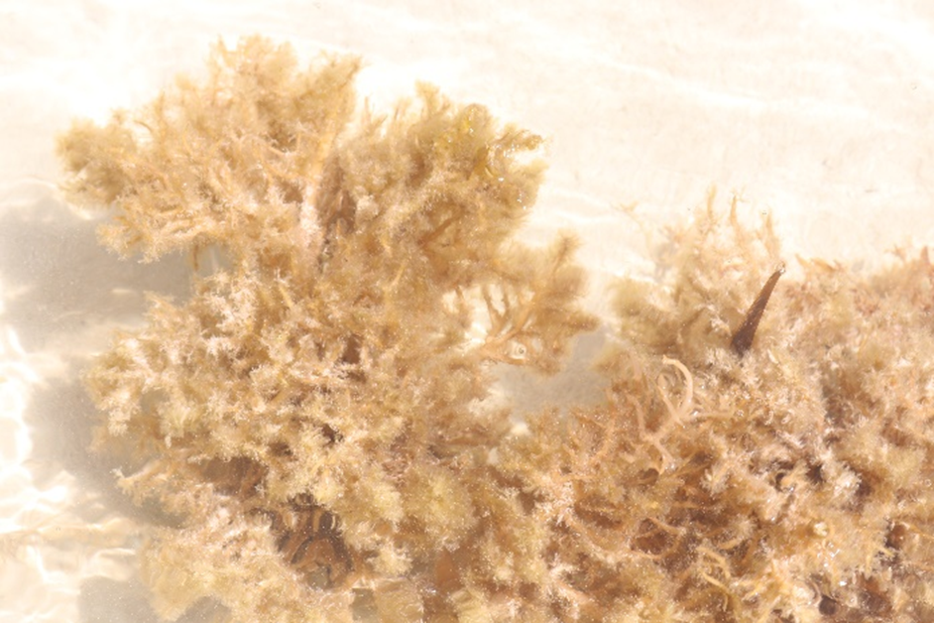
Increasing seawater temperature (31 - 38 ⁰C)
Challenges/Climate change
Diseases & pests=ice-ice, epiphytes
©F.E. Msuya
©F.E. Msuya
©F.E. Msuya
©F.E. Msuya

Slide 9
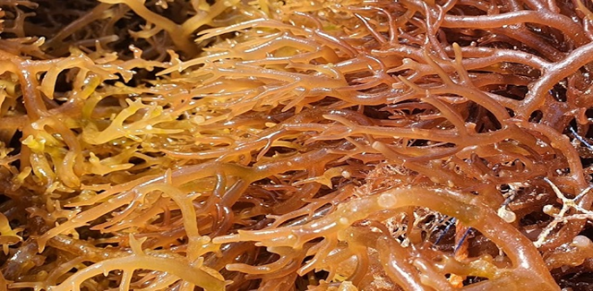
Results in: -Declining Production -Higher valued Cottonii not growing =lower income
©F.E. Msuya

Slide 10
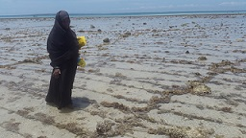
Results in: -Some farmers stopping -Farming = seasonal stop of 3 months of not farming during hot seasons
©F.E. Msuya

Slide 11
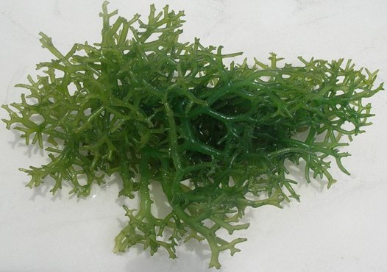
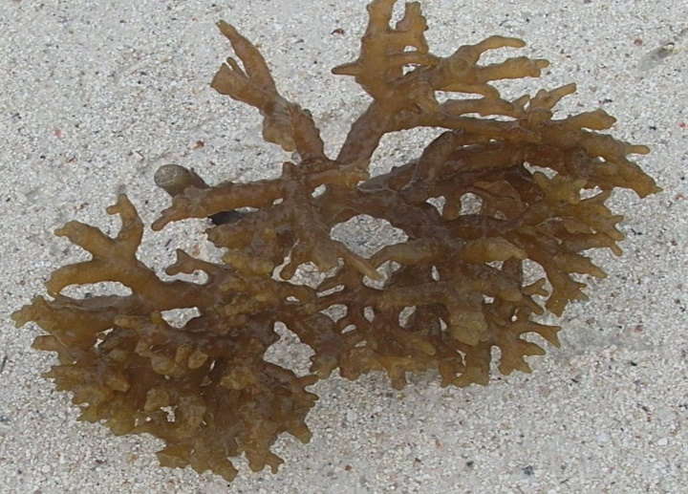
Challenges
Seed supply-Farmers lack seed after bad season
Seed supply- Nurseries? Tissue culture?
©F.E. Msuya
©F.E. Msuya

Slide 12
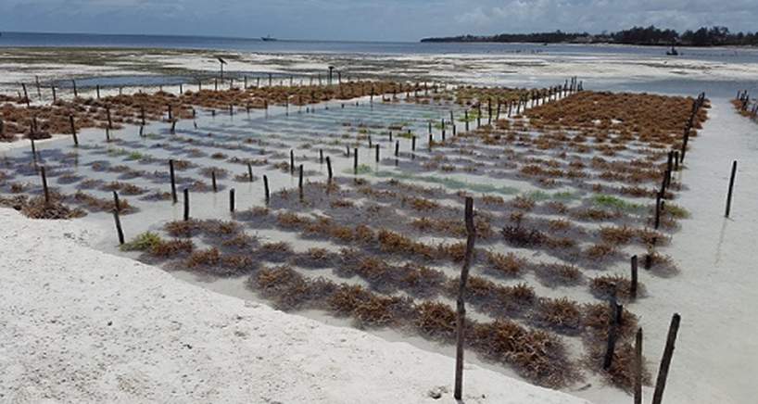
Challenges -Farming technologies
-Traditional method-off-bottom
Becoming suboptimal with time
©F.E. Msuya

Slide 13
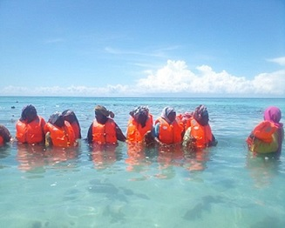
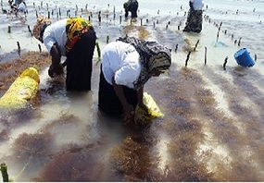
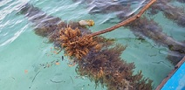
INTERVENTIONS
Farming technologies
©F.E. Msuya
Deep (2-6m at low tides)
©F.E. Msuya
©F.E. Msuya

Slide 14
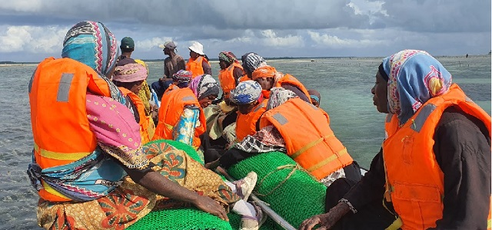
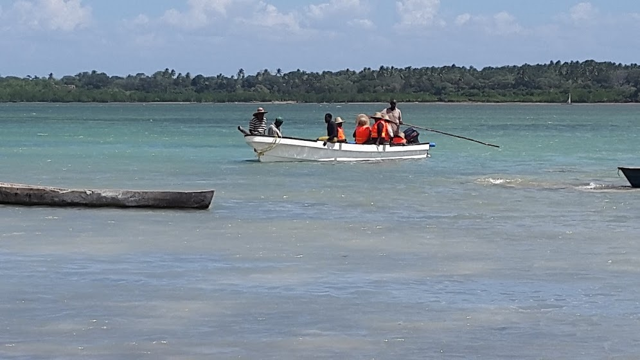
But with challenges!
©F.E. Msuya
©F.E. Msuya
Challenges faced-Deep water farming:
Women cannot swim=Swimming lessons ongoing & needed
Do not own boats needed to reach deep waters
©F.E. Msuya

Slide 15
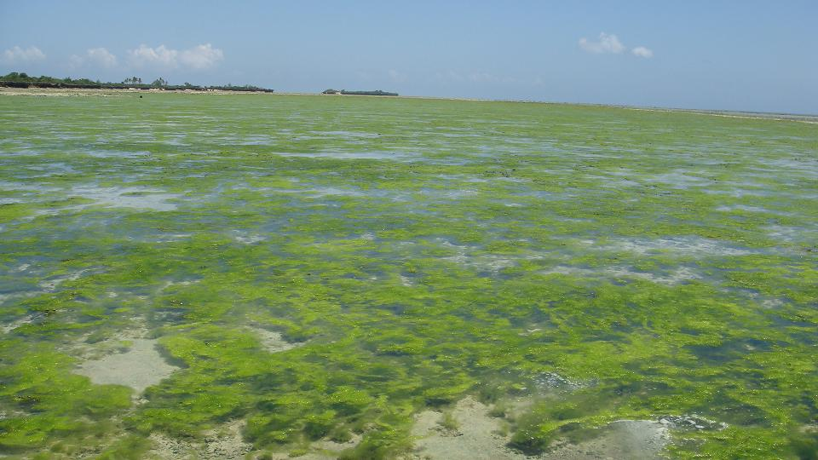
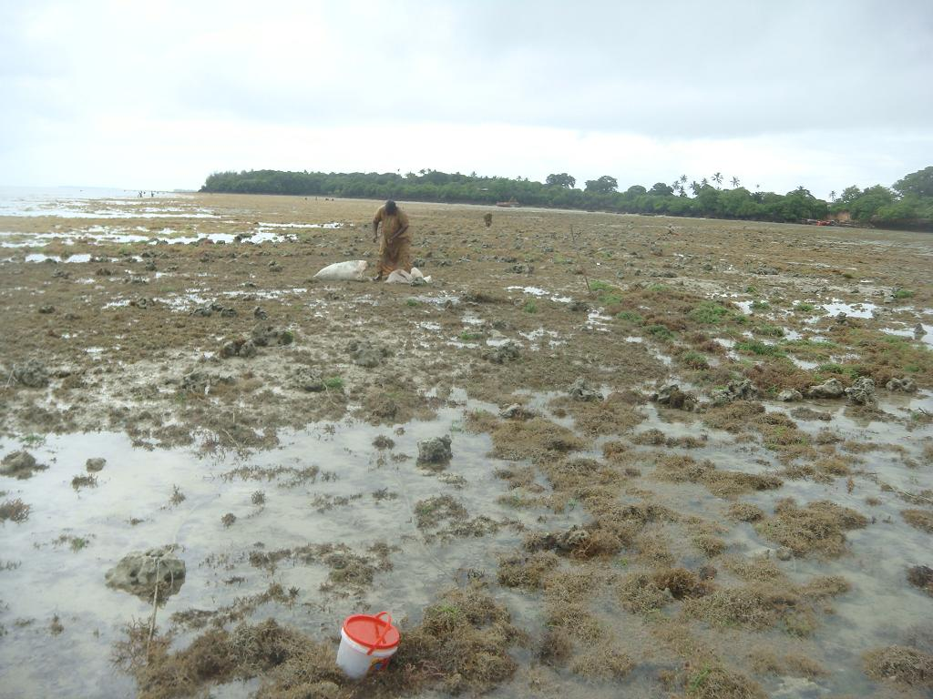
Challenges
Fouling
©F.E. Msuya
©F.E. Msuya

Slide 16
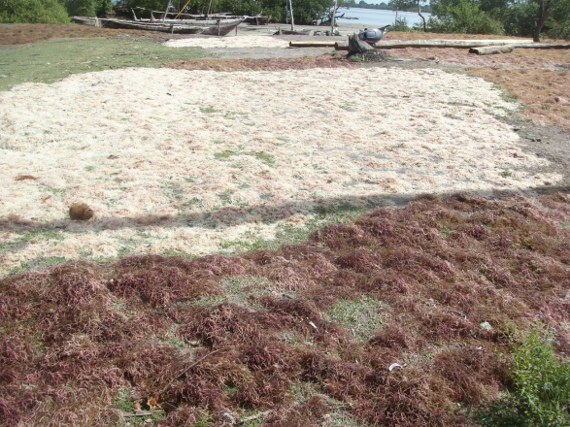
Challenges
High post harvest losses-during rainy seasons
©F.E. Msuya

Slide 17
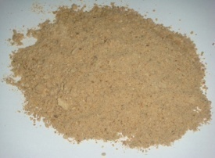
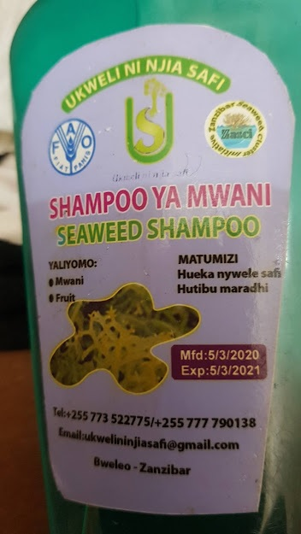
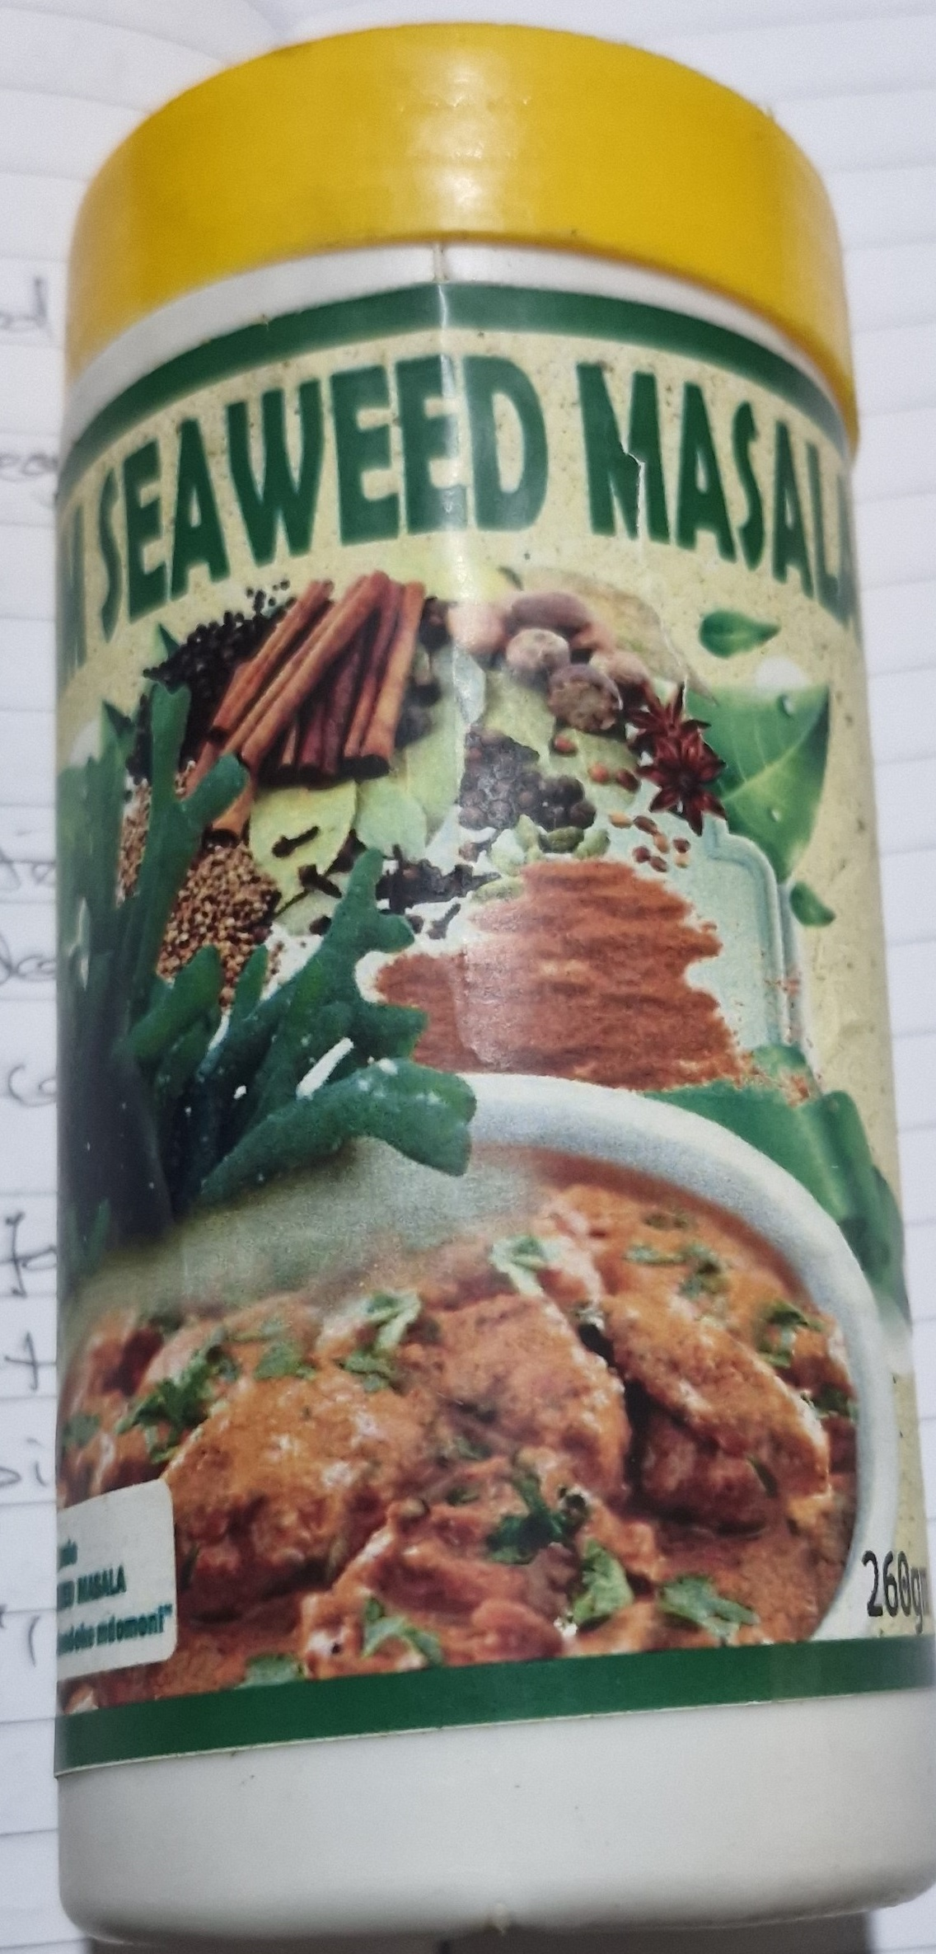
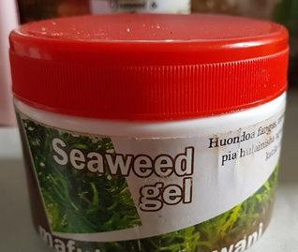
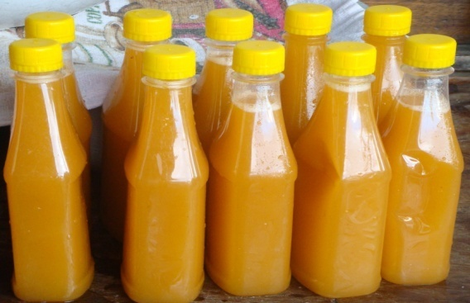
Value Addition-2006
Tanzania started making seaweed products in 2006 under Seaweed Cluster (ZaSCI)
One group in 2006 with 21 members
Now 60+ groups with 700+ processors
©F.E. Msuya
©F.E. Msuya
©F.E. Msuya
©F.E. Msuya

Slide 18
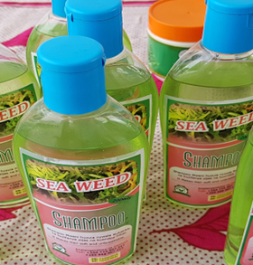
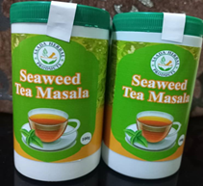
Value Addition
CONSUMPTION/SALES FOR FOOD/HEALTH ISSUES
CONSUMPTION/SALES FOR FOOD/HEALTH ISSUES
CUSTOMERS
SELLER
Processing Factories-higher prices
©F.E. Msuya
NGOs
INT. ORGANISATIONS
GOVT. PROJECTS
SEAWEED PRODUCTS (US$ 0.6-20)
FARMER
WET SEAWEED
DRY SEAWEED
(US$ 0.3)
EXPORTER
EXPORT
BUYER/
EXPORTER
SHELLFISH FOOD
LOCAL EXPORTER
(Higher price to farmers)
©F.E. Msuya
©F.E. Msuya

Slide 19
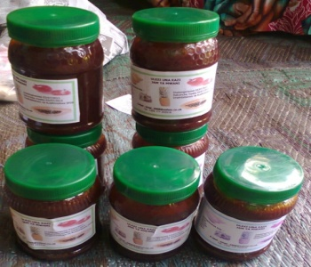
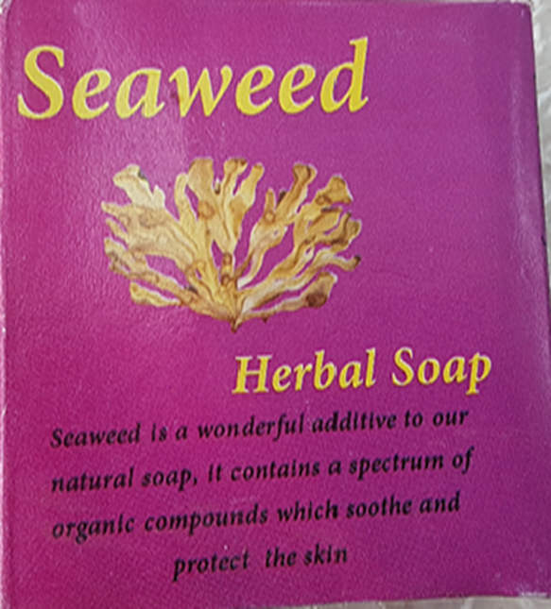
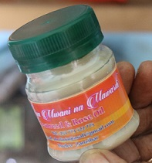
Challenges
Limited packaging materials-supply
Expensive packaging materials
Manual mixing-not uniform
Poor product finishing
Limited markets-exhibitions, tourists
No premise to work together
Still exporting ~98% of seaweed
©F.E. Msuya
©F.E. Msuya
©F.E. Msuya

Slide 20
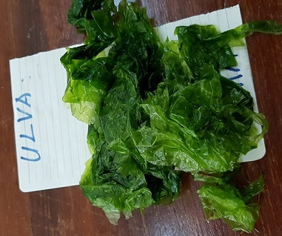
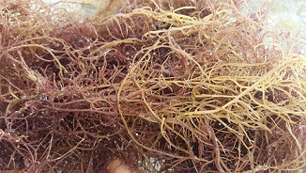
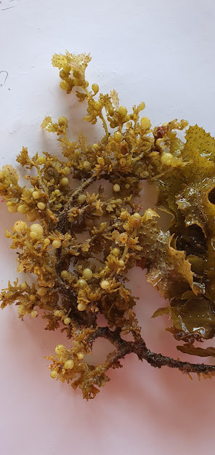
Challenge-Limited Research on other species to domesticate
Ulva spp.
©F.E. Msuya
©F.E. Msuya
Sargassum
Gracilaria (Gracilariopsis)
©F.E. Msuya

Slide 21
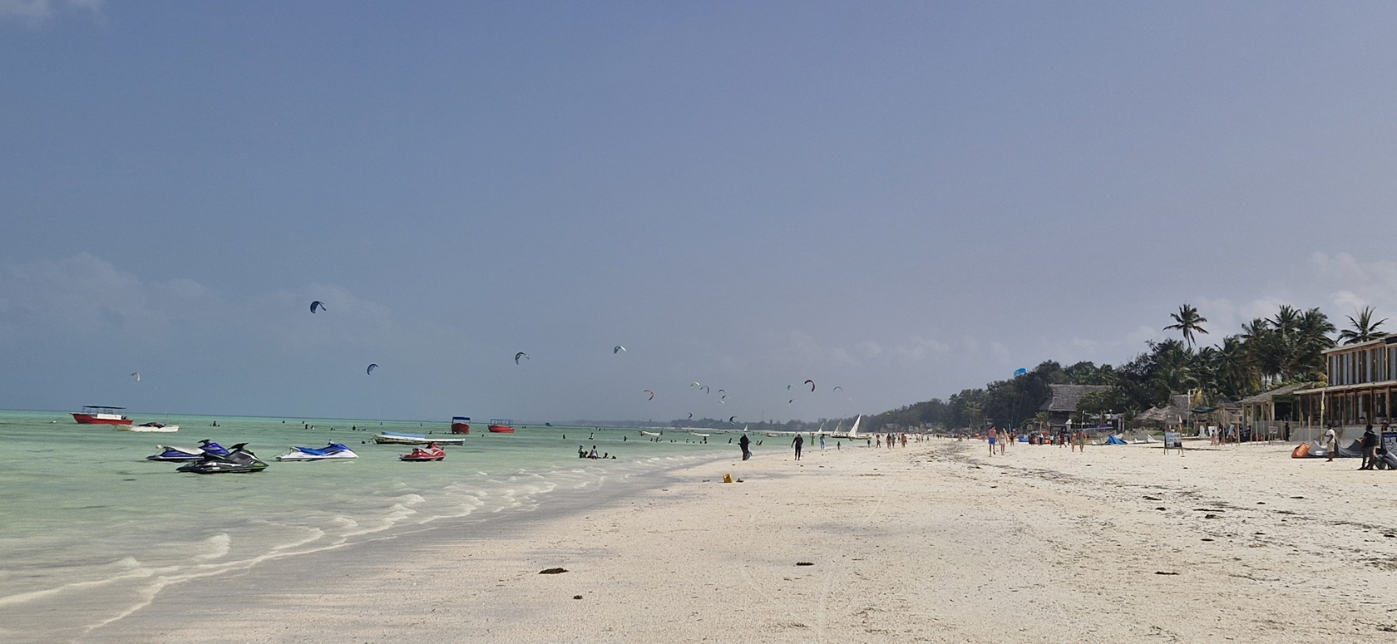
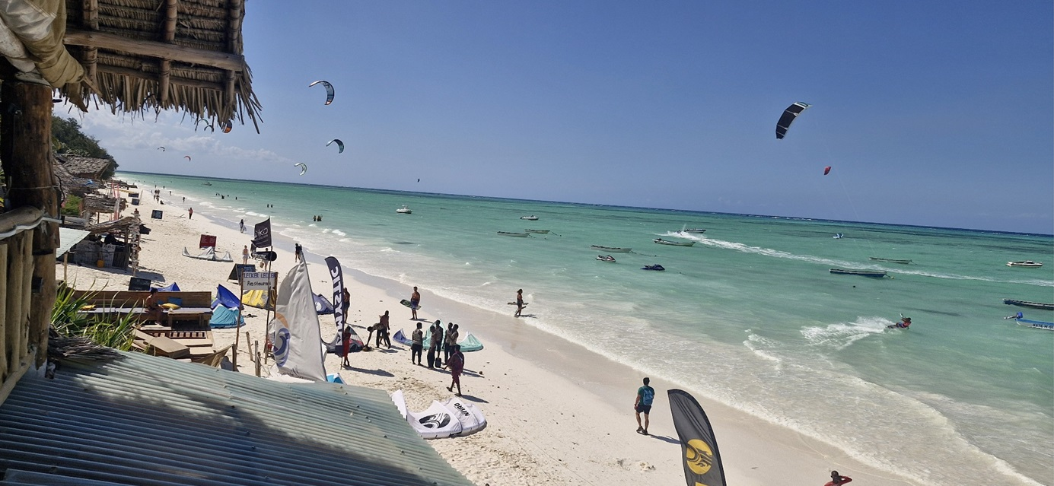
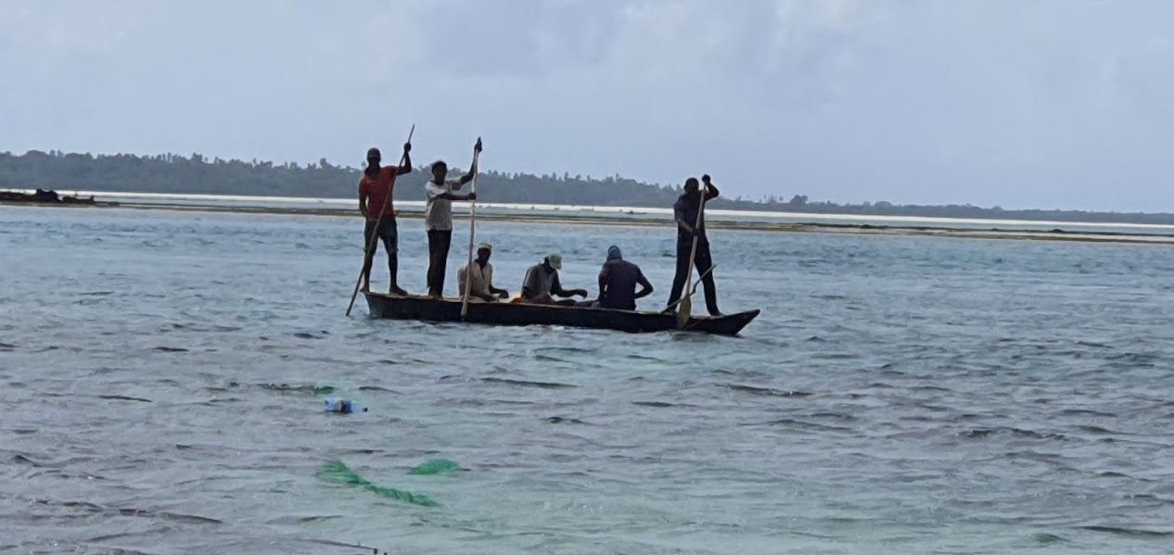
Challenges
Conflict between resource users-seaweed and tourism, fishing
Kites landing
No drying places
No passages
Dirty water
Cutting of ropes
©F.E. Msuya
©F.E. Msuya
©F.E. Msuya

Slide 22
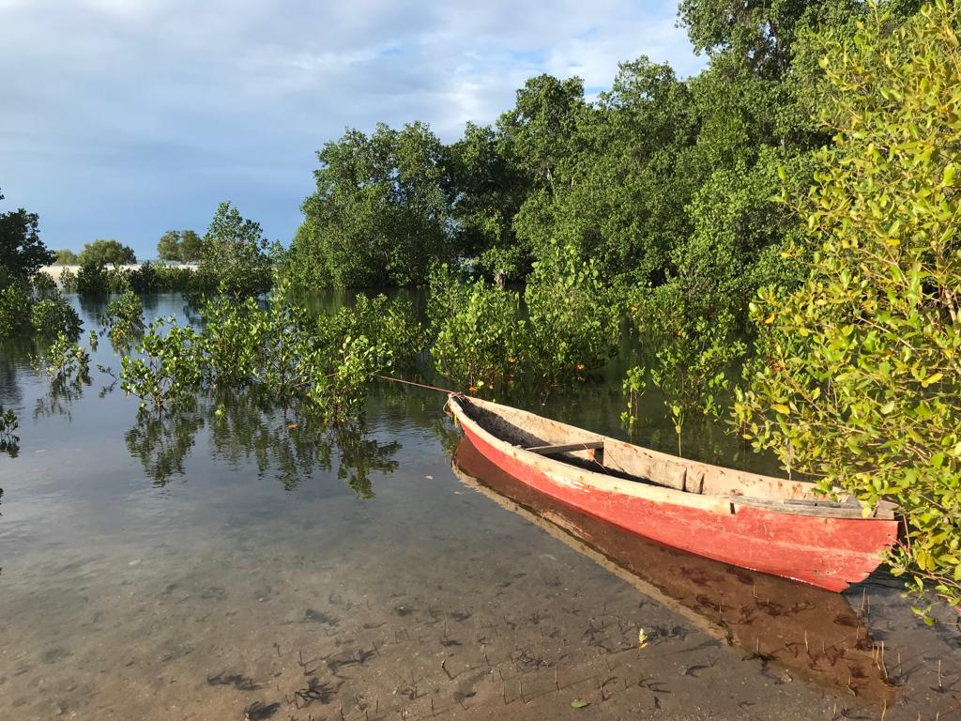
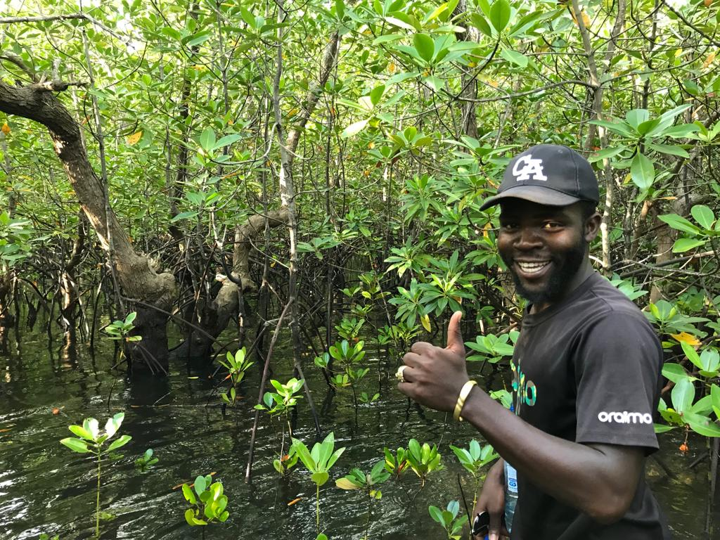
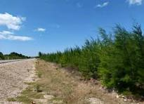
Challenges
Use of mangrove pegs?
Banned
Farmers send people to help cut pegs from coastal tree forest-sometimes timing is hard, may not be available
Tree nurseries?
©F.E. Msuya

Slide 23
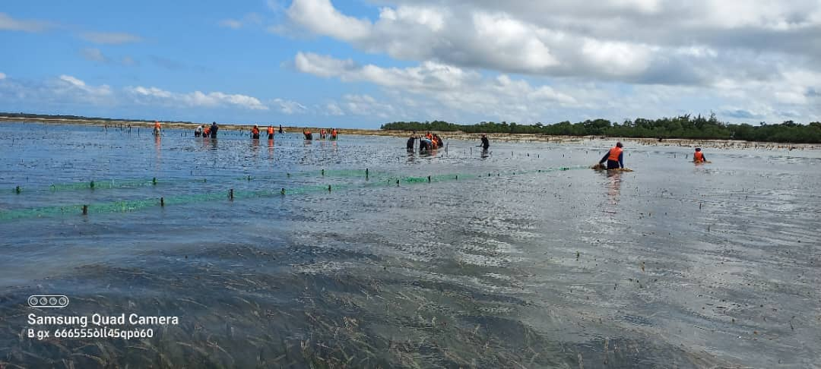
Challenges
Other aquaculture:
lack of fingerlings
Theft-Sea cucumber
land shortage
High mortality during heavy rains-low salinity
©F.E. Msuya

Slide 24
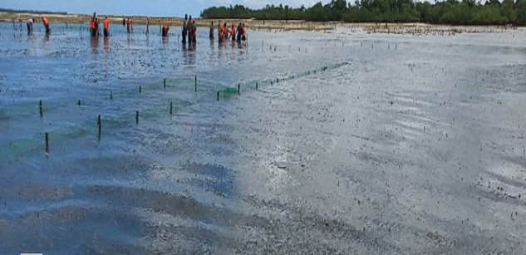
Challenges
Promote Integrated Multi-Trophic Aquaculture (IMTA)
Seaweed-sea cucumber*
Seaweed-milkfish
Challenge-Theft*
©F.E. Msuya

Slide 25
Asante sana! Thank you very much!

